Slide 1
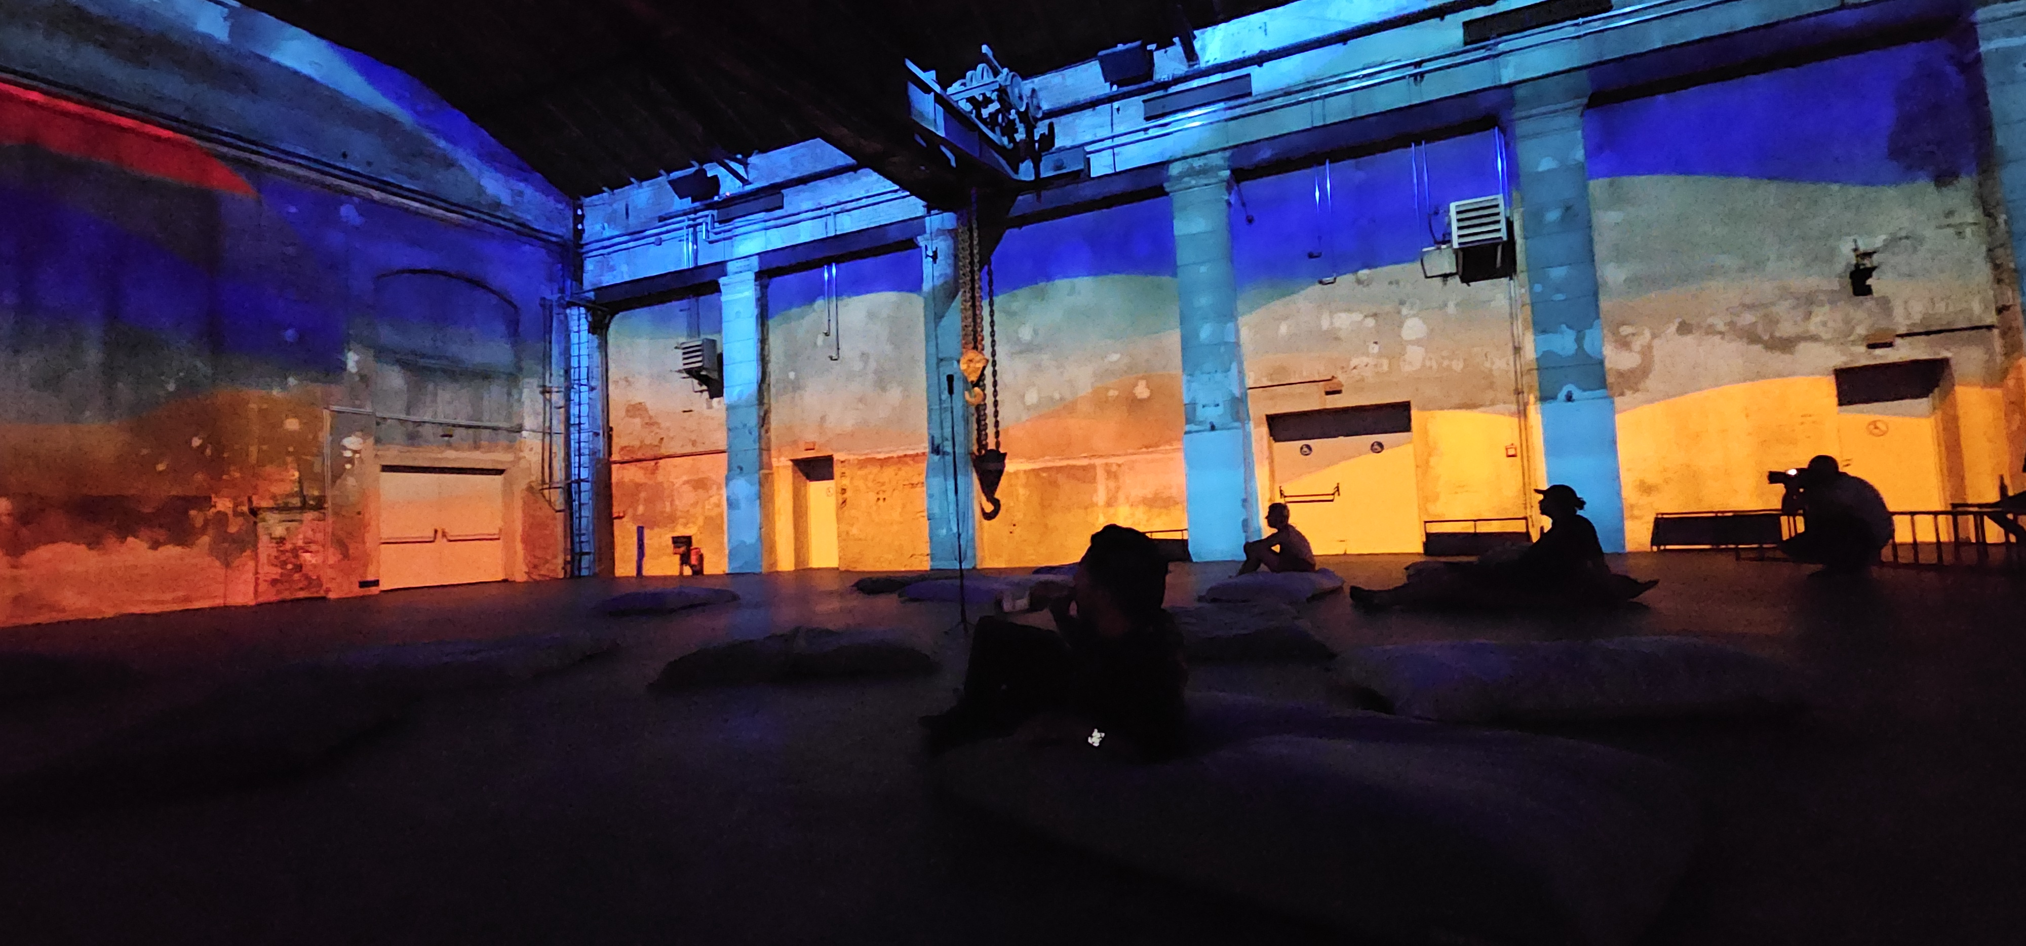
Projection Mapping Façade Mapping

Slide 2
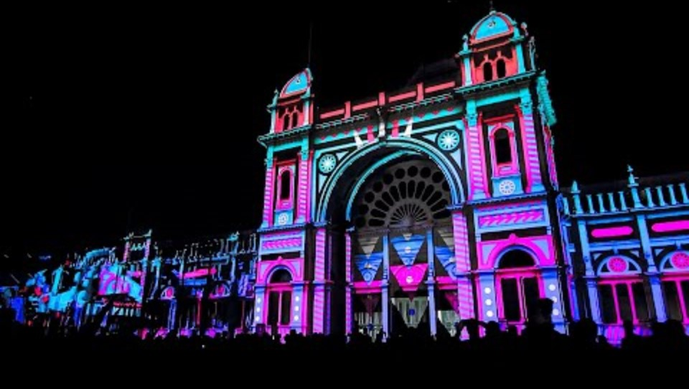

Slide 3
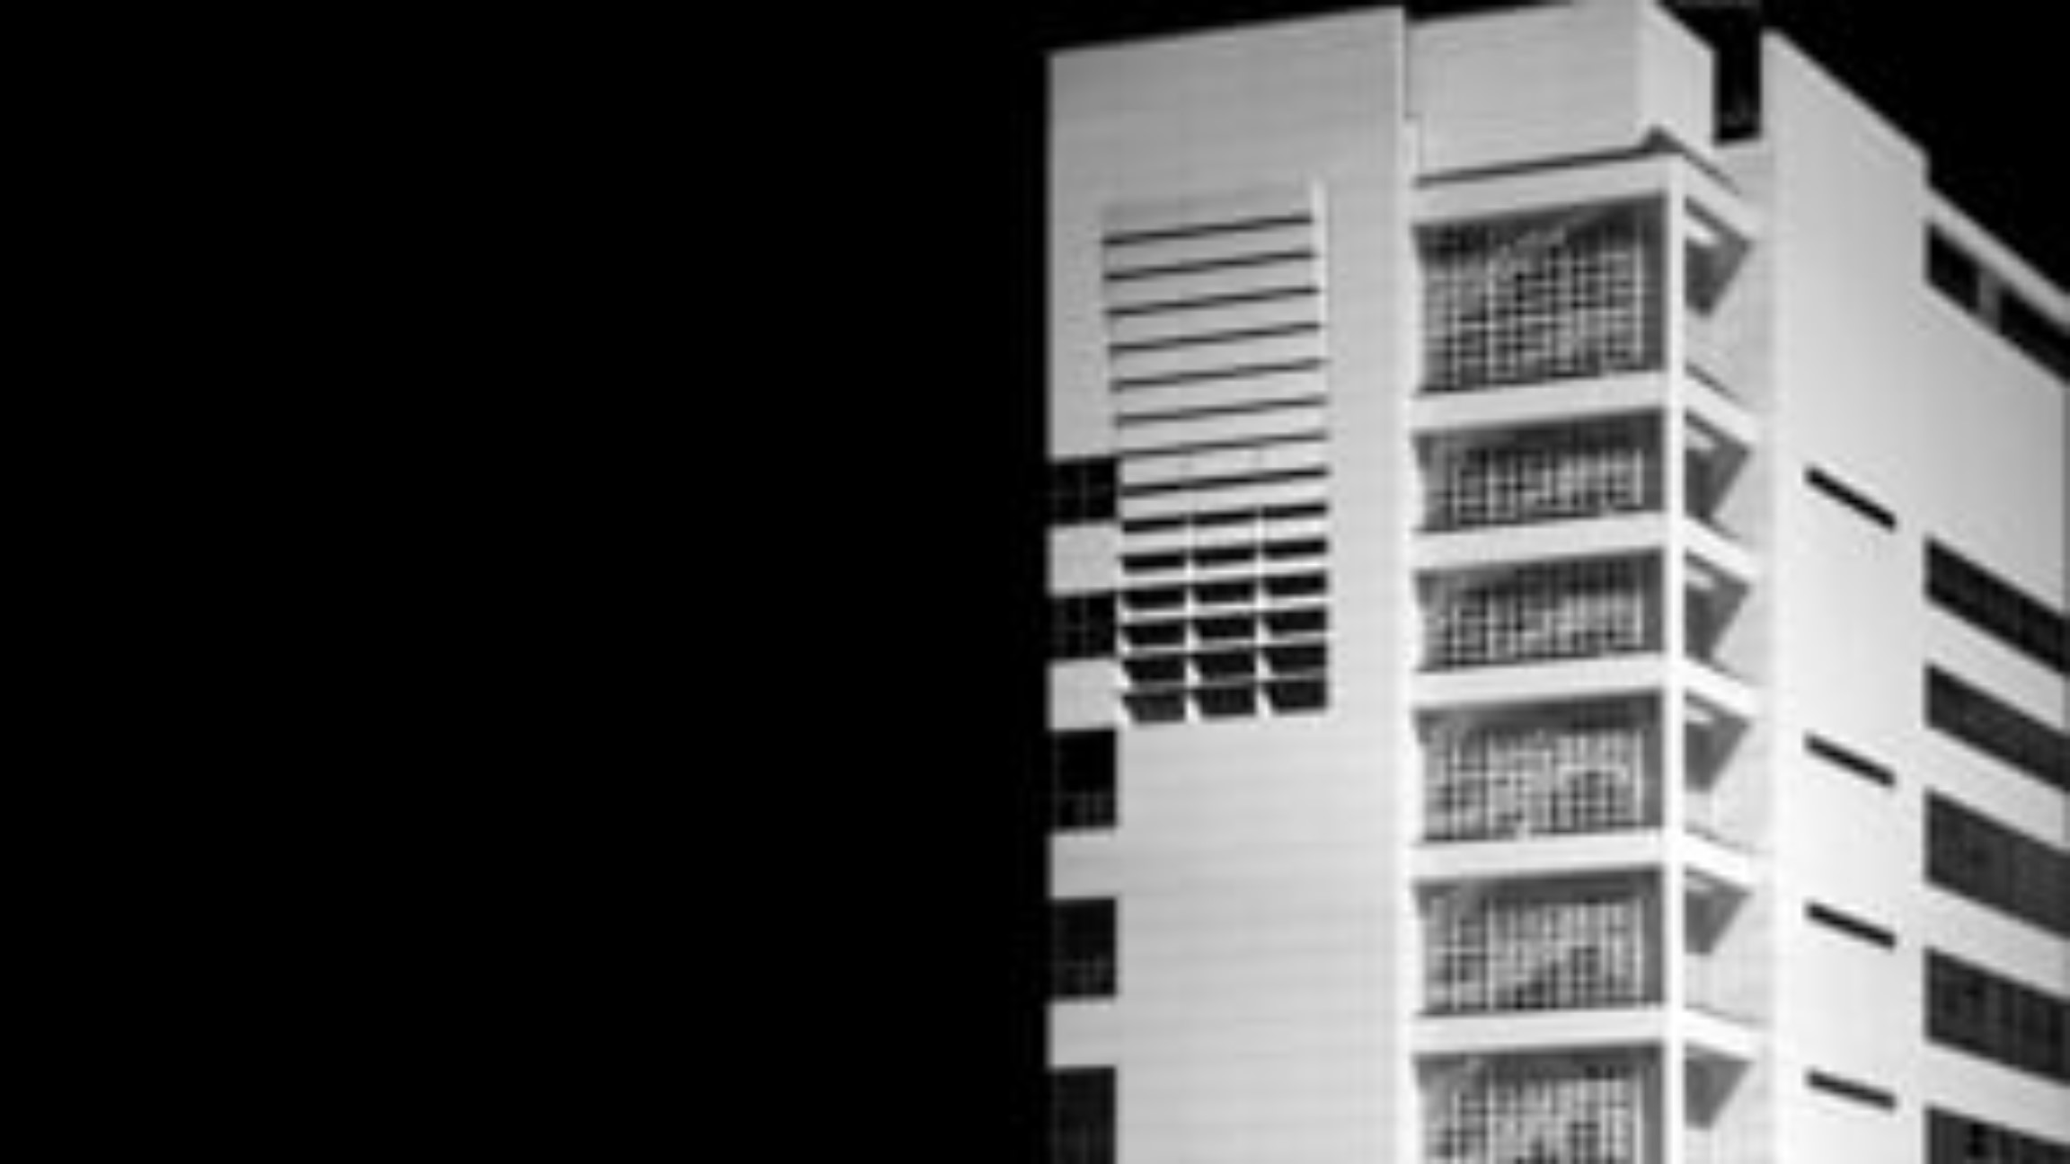

Slide 4
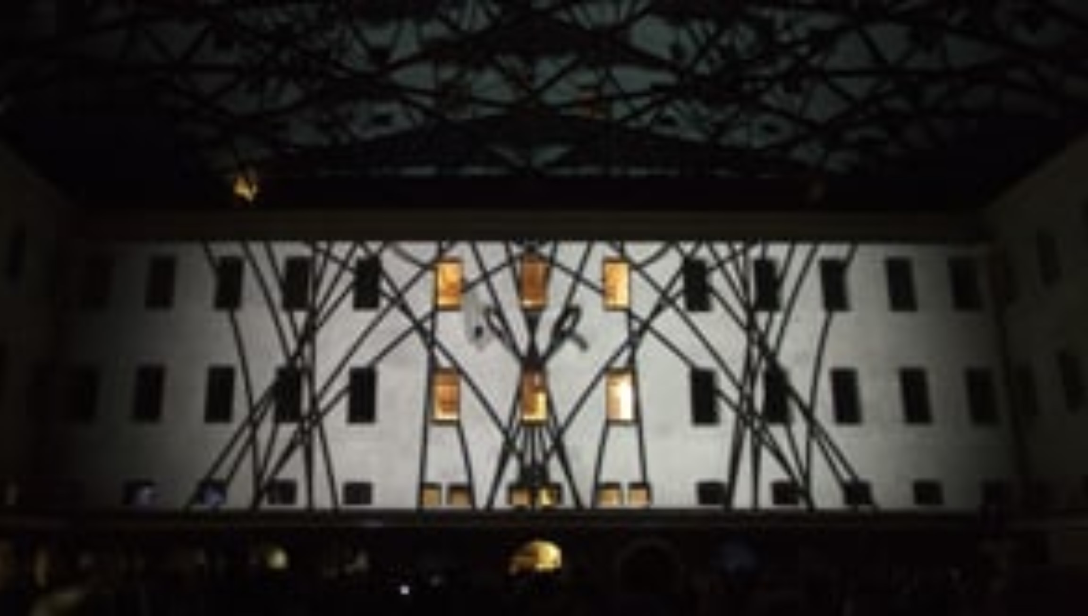
https://vimeo.com/33001491

Slide 6
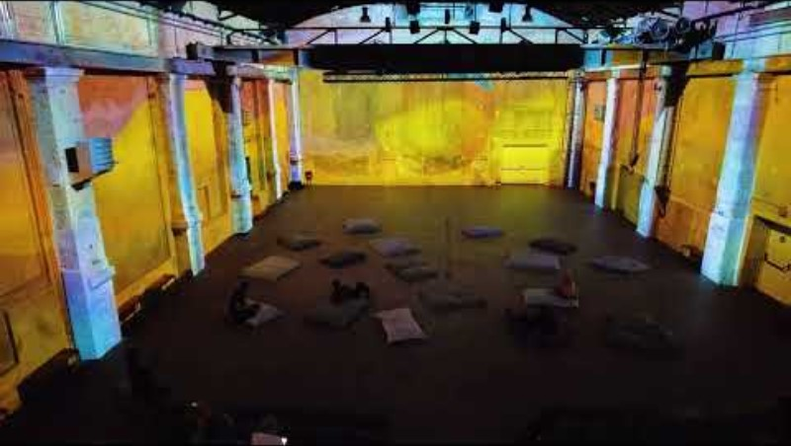

Slide 7
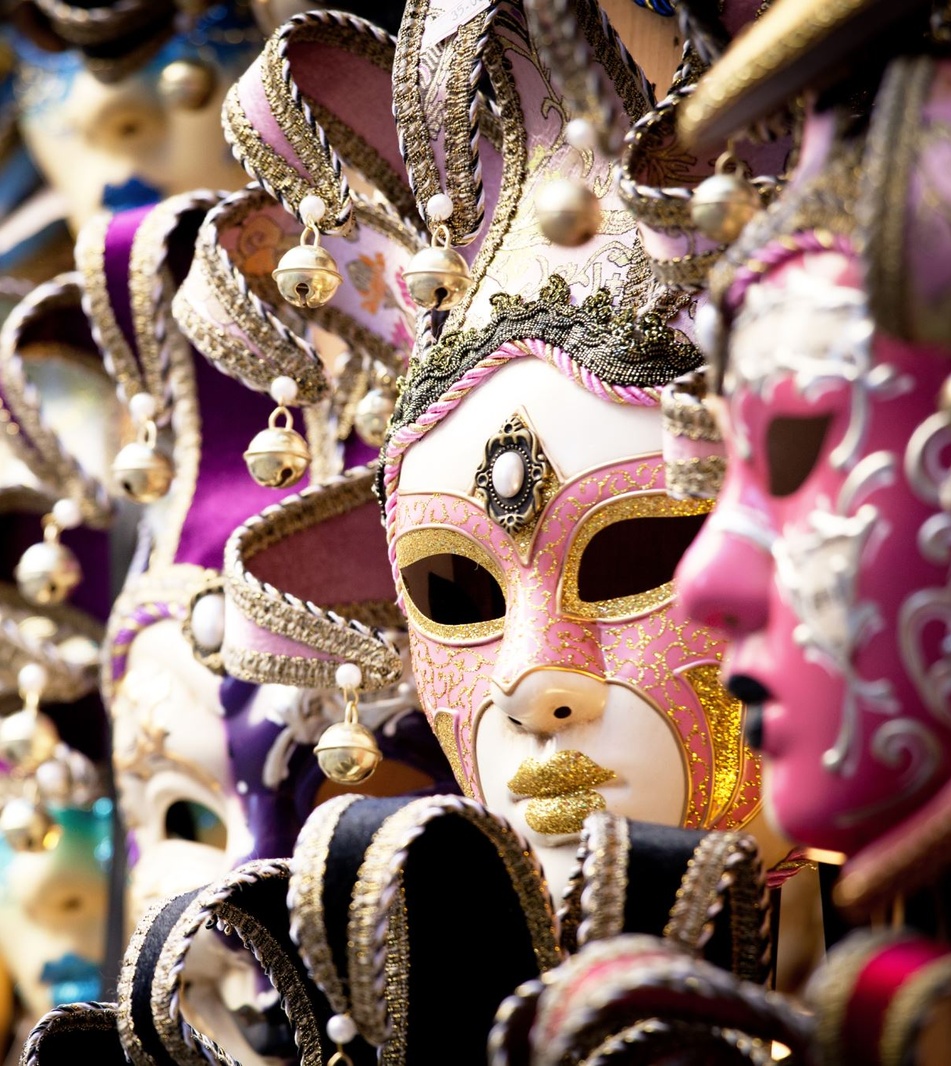
Masks

Slide 8
Mask
a mask defines specific areas of the projection surface where visuals will or won’t be displayed.
Essentially, it acts as a filter that blocks or reveals parts of the image, allowing precise control over where the projection is applied.
This is particularly important for façade mapping, where you may want to project content only onto certain architectural elements (e.g., windows, doors, or specific shapes) while avoiding other areas.

Slide 9
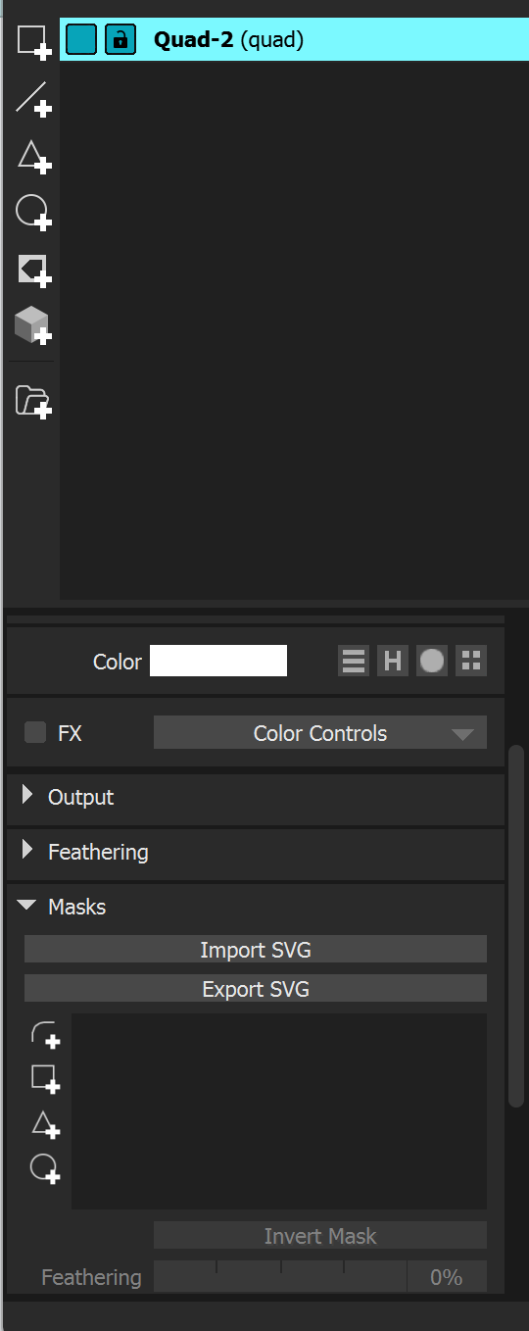
MadMaper
Although you can do it in mad mapper there are better tools.
I use TouchDesigner or After Effects.

Slide 10
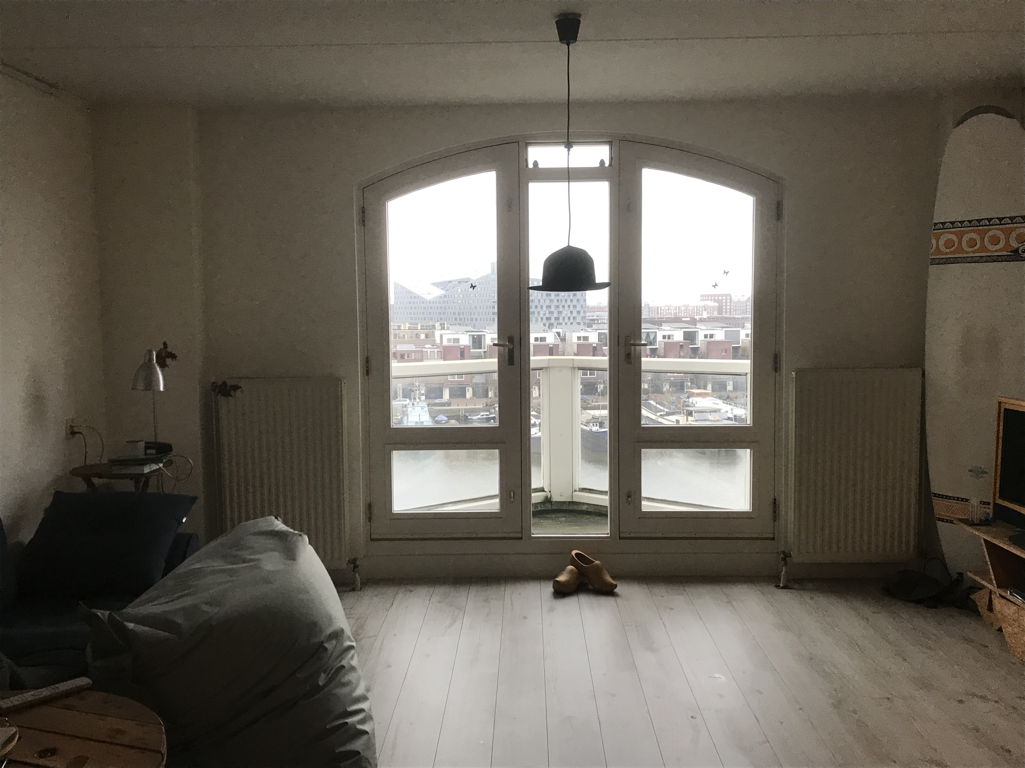
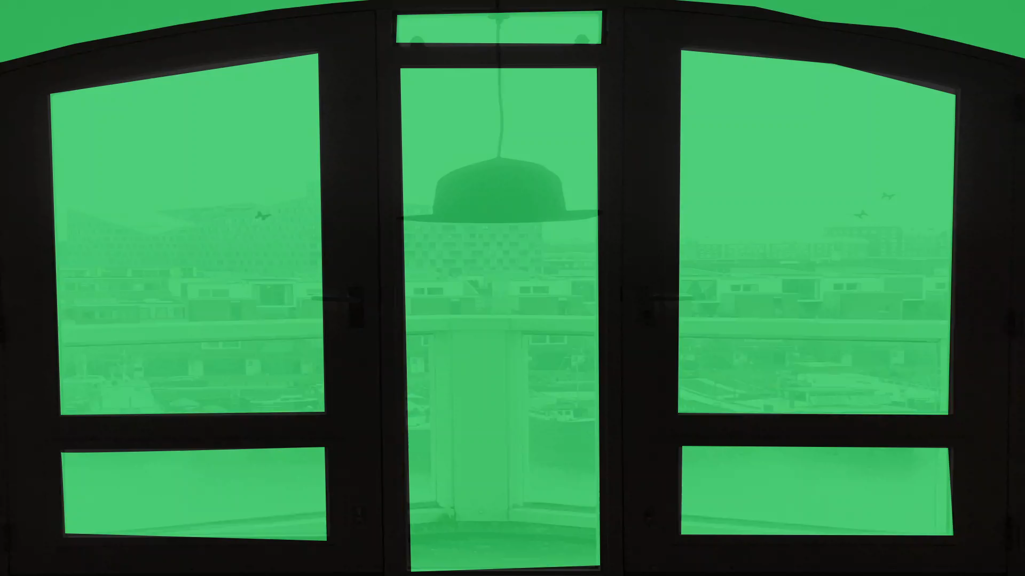

Slide 11

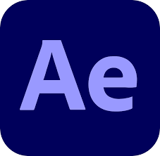
How I did it

Slide 12
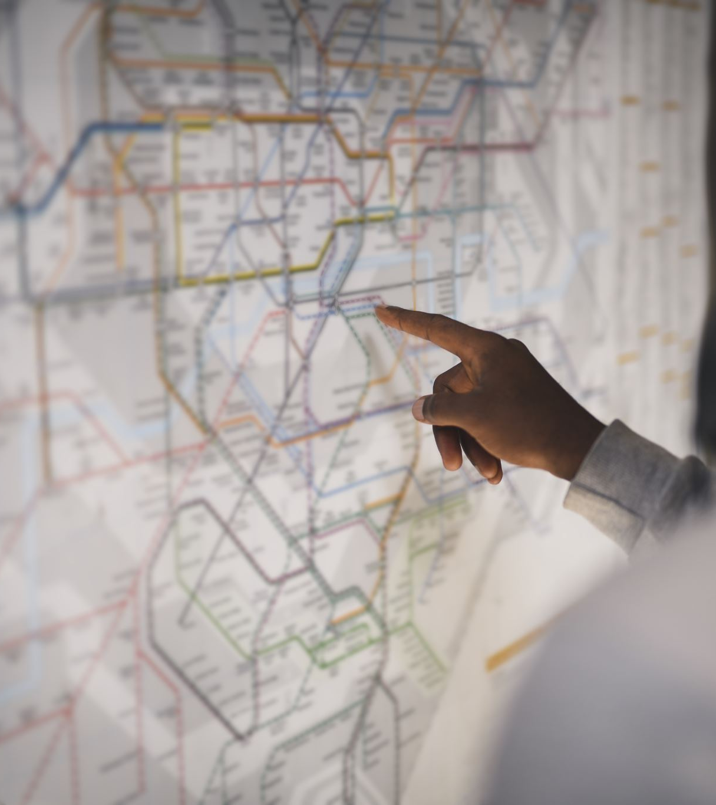
Standard steps
Plan and sketch your content and story
Make the masks you will need
Make your content
Integrate content and mask
Export to mapping software (Mad Mapper)
Map

Slide 13
Challenge

Slide 14
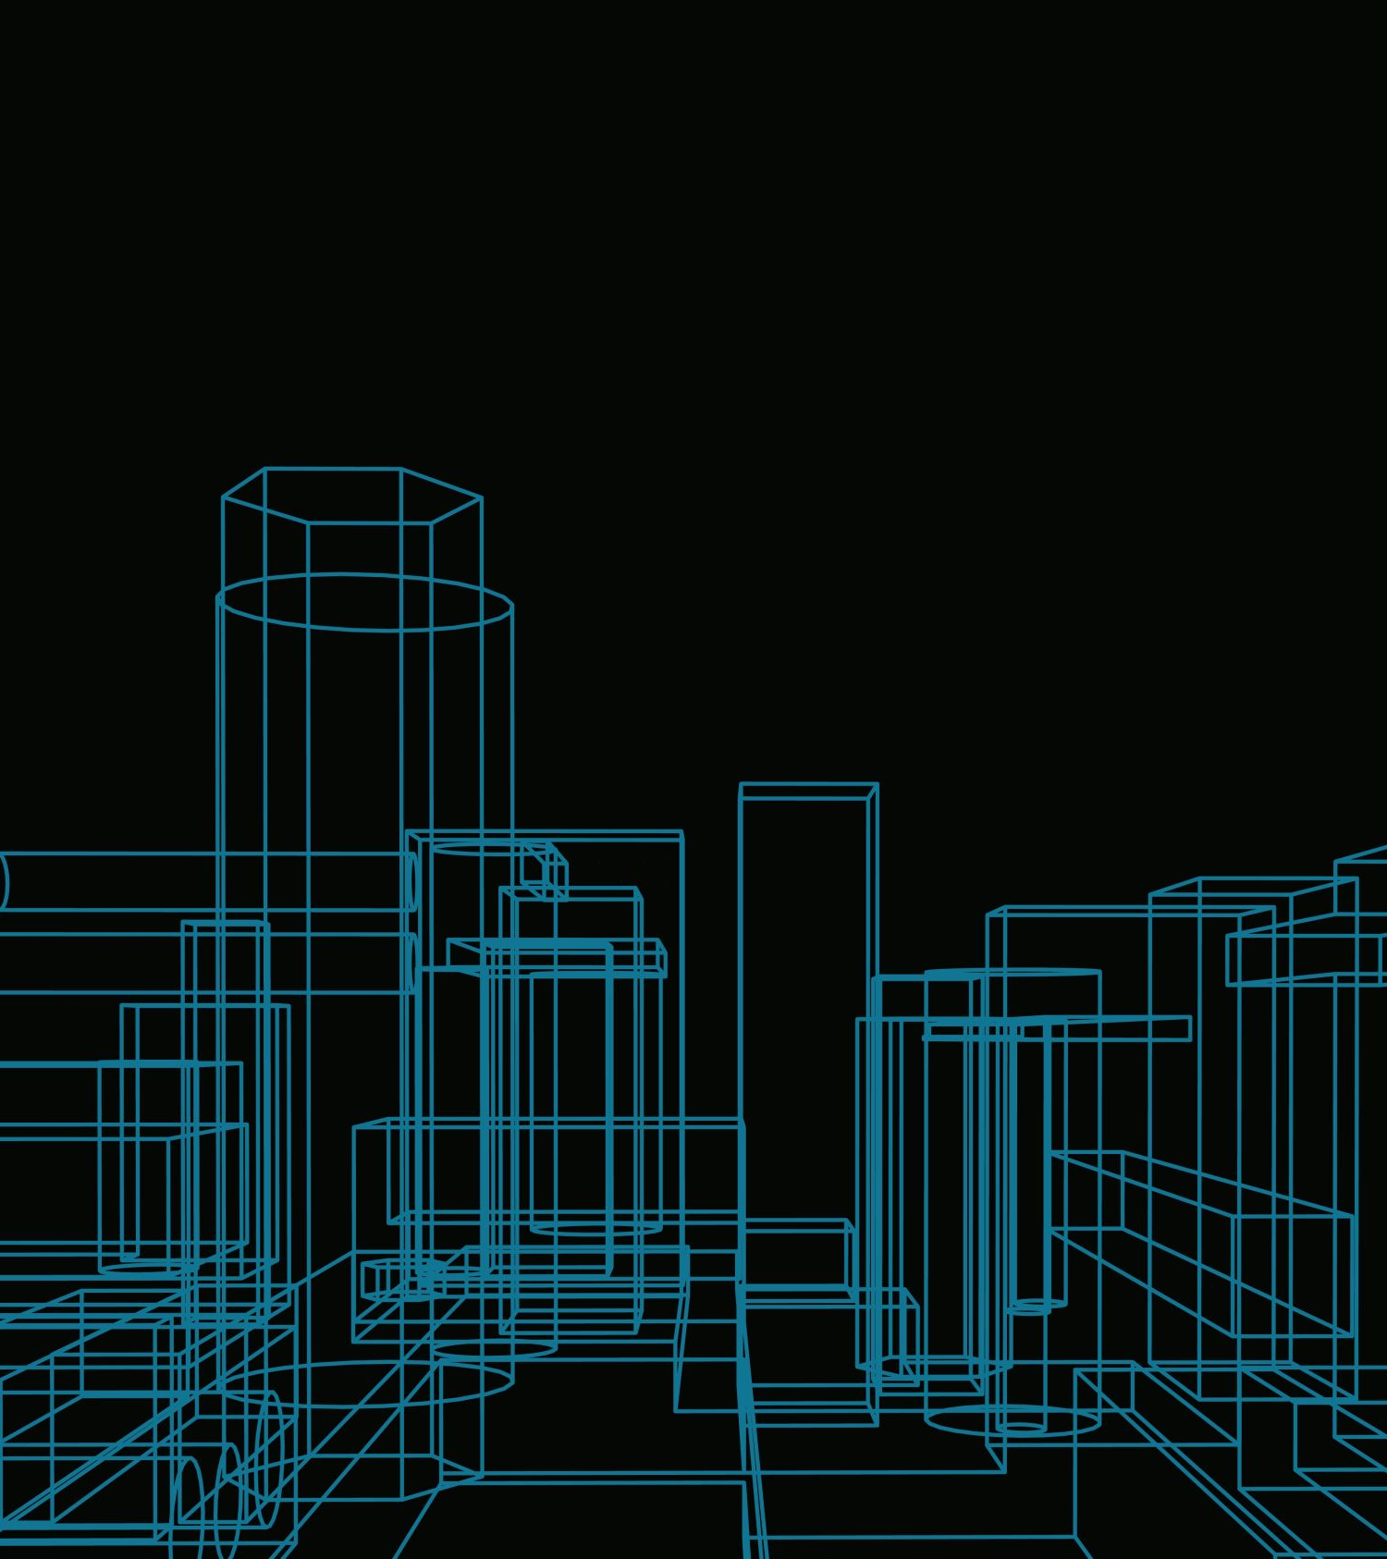
Challenge 3
Make a 2 to 3-minute projection mapping over the university buildings (mock-ups)
Make sure to bring the architectural elements into your work.
Agree with other groups on sharing projectors and their placing.
Present at ~15:10
Extra-mile: use two projectors (or more)

Slide 15
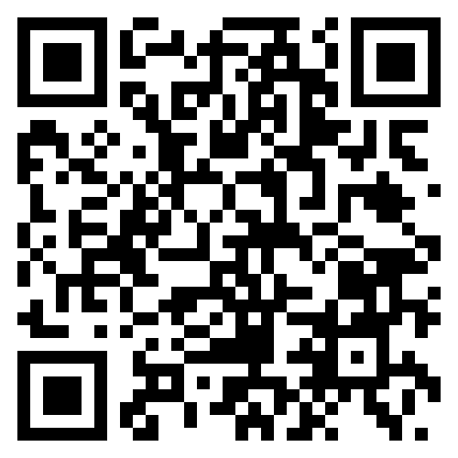
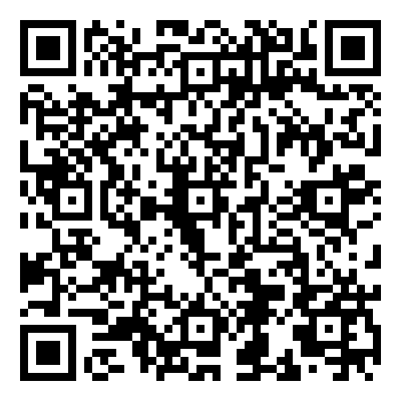
Links
Git repository
https://github.com/Rauleal/AVD-Minor-HU/
AE Saber plugin

Slide 16

Thank you

